Slide 1
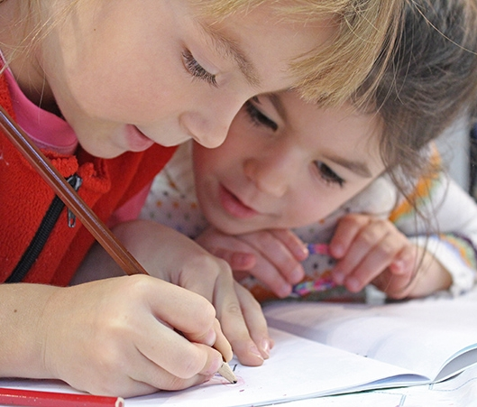
At school
Years 1 and 2
Makedonitissa A’
Primary School 2019-2020

Slide 2
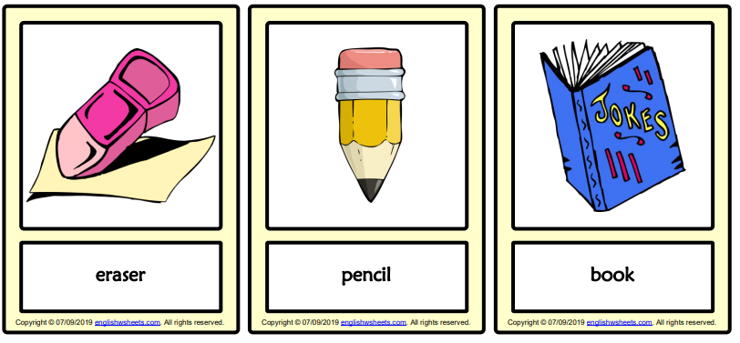

Listen, look and…remember!
rubber
https://www.englishwsheets.com/

Slide 3
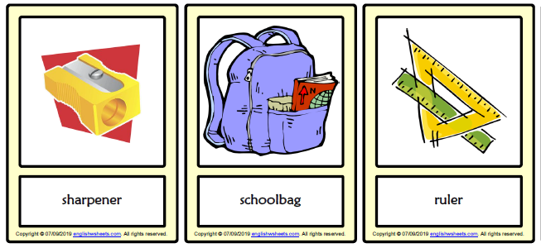
Listen, look and…remember!
https://www.englishwsheets.com/

Slide 4
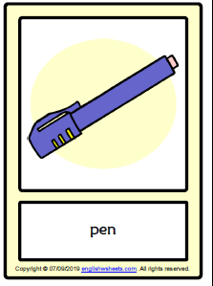

Listen, look and…remember!
https://www.englishwsheets.com/

Slide 5
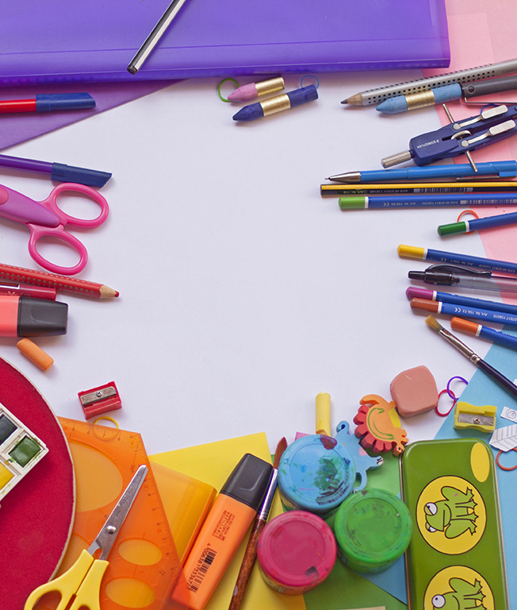
Let’s sing and play!
Listen to the song and sing along!
https://www.youtube.com/watch?v=hjFaqDNUVFo
https://learnenglishkids.britishcouncil.org/word-games/school-things-1
https://learnenglishkids.britishcouncil.org/archived-word-games/find-the-pairs/school
Listen and match the words with the pictures.
Play a memory game!

Slide 6
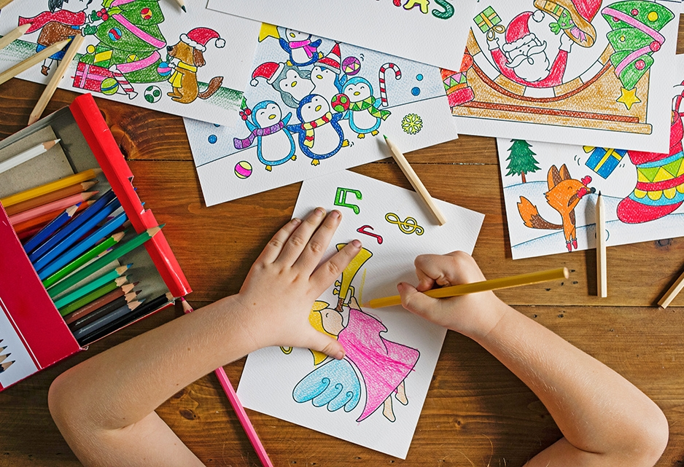
Listen and draw!
4.When you finish, move on to the next slide to check your drawing!

Slide 7




Time to check!
http://clipart-library.com/

Slide 8

Great work!
Keep it up!

