Slide 1
About me!

Slide 2
First complete these sentences in your exercise book:
My name is…………………...
I’m from……………………….
I live in…………………………
I like……………………………..
I don’t like…………………..
I’ve got…………………………

Slide 3
Let’s read about two famous people and play a memory game!

Slide 4
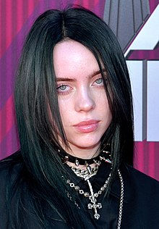
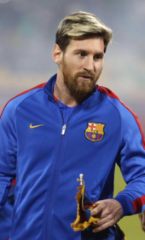
Hi everyone! I am Lionel Messi! I am 32 years old. I come from Argentina but I live in Barcelona, in Spain. I am a football player. I love football. I like dogs, too. I’ve got a big brown dog.
Hi everyone! I am Billie Eilish!
I am 18 years old. I am a singer. I come from the USA. I live in Los Angeles with my family. I like fruit and vegetables. I like animals, too. I’ve got a dog and a cat. What about you?

Slide 5

Let’s check your memory!
Do you remember who says what?
Good Luck!!!
Click below and do the quiz.
http://www.quia.com/quiz/7652524.html

Slide 6
LET’S PLAY!
Click below to play a matching game. Match the questions with the answers.
http://www.quia.com/jg/3110318.html
Have fun!!!

Slide 7

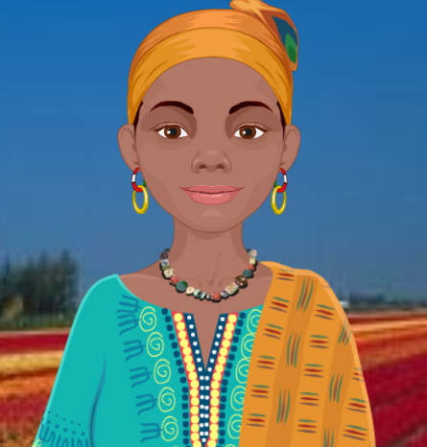
Listen and complete the following in your exercise book :
Hi! I’m Amara. I’m ……..years old. I’m from……….. I ………. in Kenya with my family. I like fruit. I ……………. mangoes and pineapples. I ………....… bananas. I like animals too. I’ve got a ………… It’s blue, ………….., yellow and …………..

Slide 8
Now, write a paragraph about you.
(Write it in your exercise book).
Put your picture here
Hi! I’m ………………… I’m ……..years old. ………………………………………………………………………………………………………………………………………………………………………………………………………………………………………………………………………………………………………………………………………………………………………………………………………………………….

Slide 9
Images courtesy of:
https://en.wikipedia.org/wiki/Lionel_Messi
https://en.wikipedia.org/wiki/Billie_Eilish
Presentation designed by the English Curriculum Development team, Cyprus Ministry of Education and Culture

