Slide 1




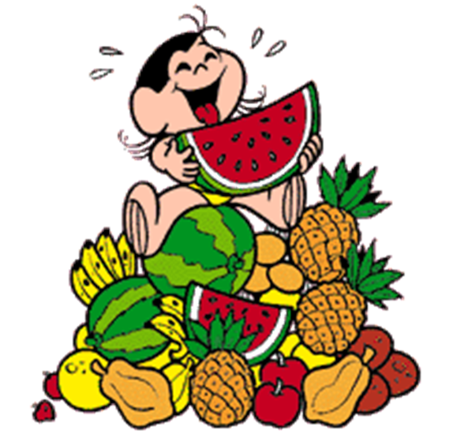
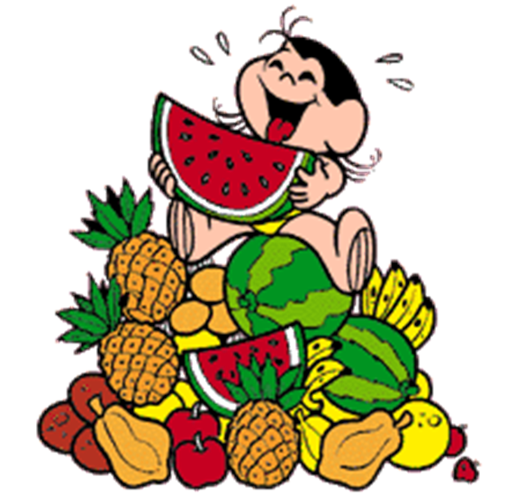
My favourite food

Slide 2


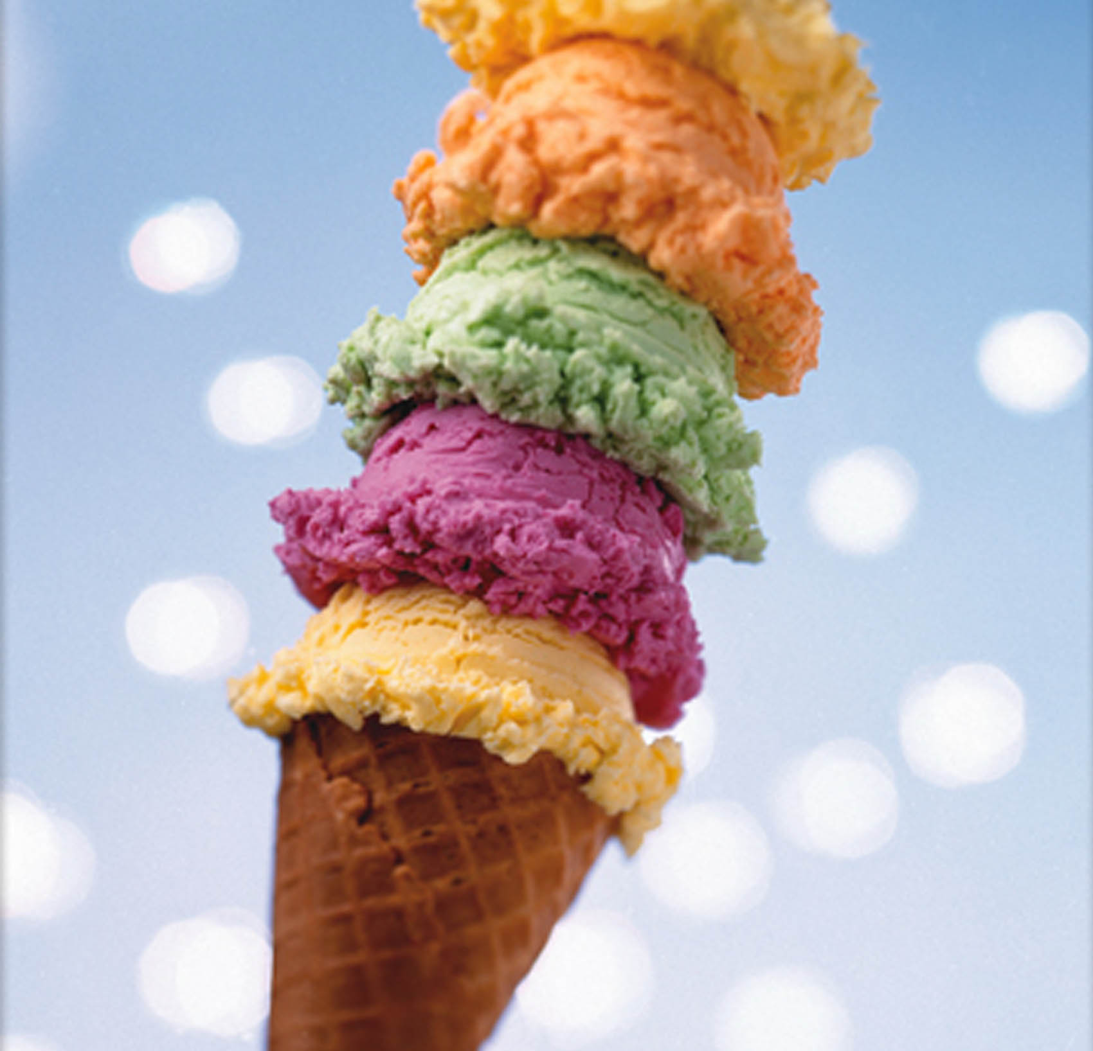









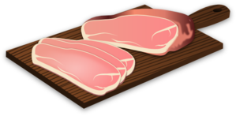


Let’s remember!
chips
coffee
ice-cream
pizza
milk
hamburger
cheese
water
ham
cake
egg
tea

Slide 3

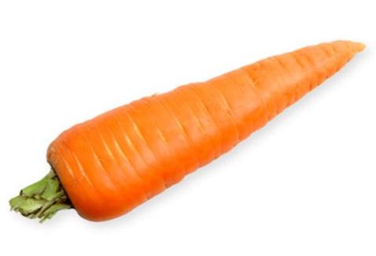





carrot
apple
pear
banana
avocado
orange
tomato

Slide 4



I like pizza.
I don’t like cake.
I like cheese.
I don’t like milk.

Slide 5
What do you like?
I like…
I don’t like…

Slide 6
Let’s sing a funny song!
Click on the link below to listen to the song :
https://www.youtube.com/watch?v=frN3nvhIHUk
Write words you remember from the song.
2. Let’s listen to the song again! Try to sing along!

Slide 7
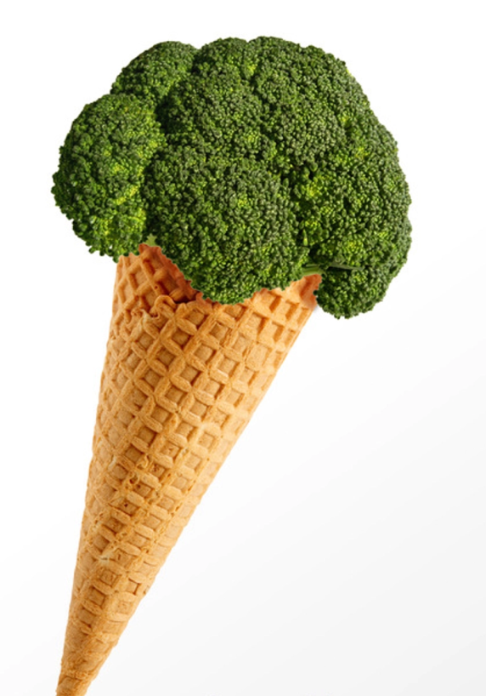
Draw something funny.
Example: I don’t like broccoli ice cream!!!

Slide 8
Let’s do a quiz!
Are you ready?

Slide 9


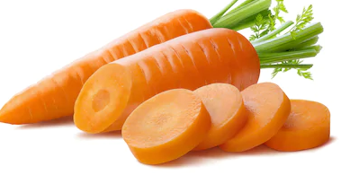
Click on the right picture!
I like carrots.

Slide 10
TRUE
CONTINUE THE QUIZ

Slide 11
FALSE
CONTINUE THE QUIZ

Slide 12

I don’t like coffee.

Slide 13
TRUE
CONTINUE THE QUIZ

Slide 14
FALSE
CONTINUE THE QUIZ

Slide 15



I like pears.

Slide 16
TRUE
CONTINUE THE QUIZ

Slide 17
FALSE
CONTINUE THE QUIZ

Slide 18


I don’t like tea.

Slide 19
TRUE
CONTINUE THE QUIZ

Slide 20
FALSE
CONTINUE THE QUIZ

Slide 21


I like cheese.

Slide 22
TRUE
CONTINUE THE QUIZ

Slide 23
FALSE
CONTINUE THE QUIZ

Slide 24

I like pizza.

Slide 25
TRUE
CONTINUE THE QUIZ

Slide 26
FALSE
CONTINUE THE QUIZ

Slide 27


I don’t like chicken.

Slide 28
TRUE
CONTINUE THE QUIZ

Slide 29
FALSE
CONTINUE THE QUIZ

Slide 30


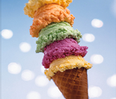
I like cakes.

Slide 31
TRUE
CONTINUE THE QUIZ

Slide 32
FALSE
CONTINUE THE QUIZ

Slide 33

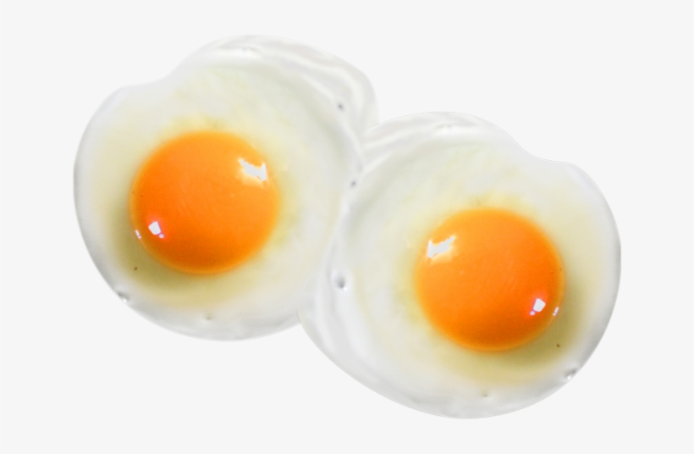
I don’t like eggs.

Slide 34
TRUE
CONTINUE

Slide 35
FALSE
CONTINUE

Slide 36
Let’s play!
Clicks on the links below:
http://www.quia.com/jg/3110590.html
https://learnenglishkids.britishcouncil.org/word-games/food-1

Slide 37

Creative activity

Slide 38
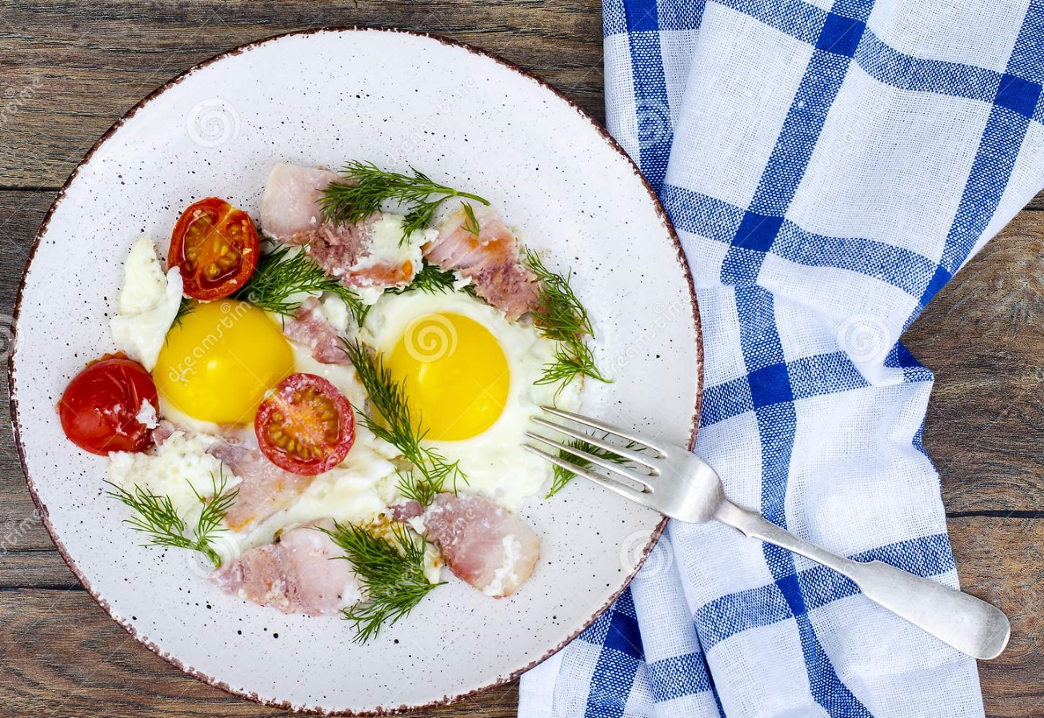
Take a piece of paper.
Draw your favourite food.
Write sentences like in the example.
I like tomatoes.
I like ham and eggs, too!

Slide 39
Images courtesy of:
https://store-images.s-microsoft.com/image/apps.21783.13510798887624207.d9a8941a-5e9a- 4437-8b47-dd1c77c11d26.0fb82261-dc63-4788-a2f4-a105be2a2f44?mode=scale&q=90&h=200&w=200&background=%23000000
https://ctl.s6img.com/society6/img/BV7I9oCQvyF562wJ7oCn8Rxcg0k/w_1500/prints/~artwork/s6-0032/a/15130129_8976245/~~/broccoli-ice-cream-prints.jpg
http://www.clker.com
Presentation designed by the English Curriculum Development team,
Cyprus Ministry of Education and Culture

