Slide 1
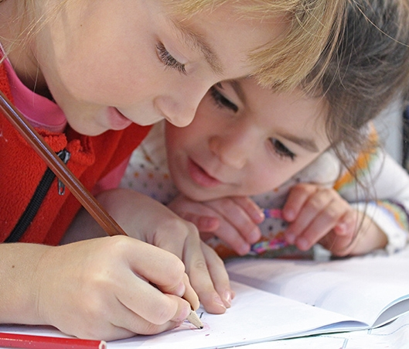
Making questions
Year 4
Makedonitissa A’
Primary School
Eleni Papageorgiou 2020

Slide 2
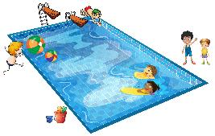
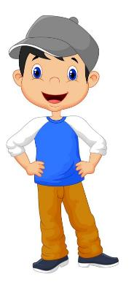
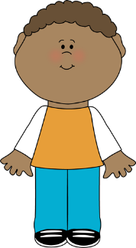

Look and learn
I play football on Monday.
Do you play football on Monday?
No, I don’t. I go swimming on Monday.

Slide 3
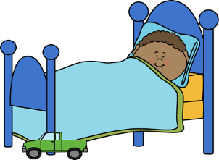
Look and learn
I go to bed at nine o’clock.
Do you go to bed at nine o’ clock?
Yes, I do. I go to bed at nine o’ clock too!

Slide 4
Look and learn
You play the guitar every day.
- Do you play the guitar every day?
-Yes, I do. / No, I don’t.

Slide 5
Put the words in the right order to make a question.
you
play
on
Do
tennis
Monday
?
Do you play tennis on Monday?
Yes, I do./No, I don’t.
Now, you can do exercise 3, on page 45 in your Activity Book.

Slide 6
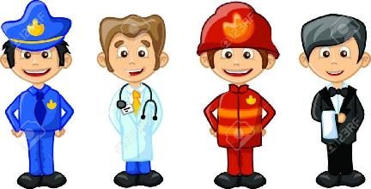
You can also…
Click below to remember the activities on professions (jobs)
and do exercises 1 and 2 on pages 44 and 45 in your Activity Book.
http://dim-makedonitissa1-lef.schools.ac.cy/data/uploads/koronavirus/english/year-4-suggested-activities-english.pdf

Slide 7
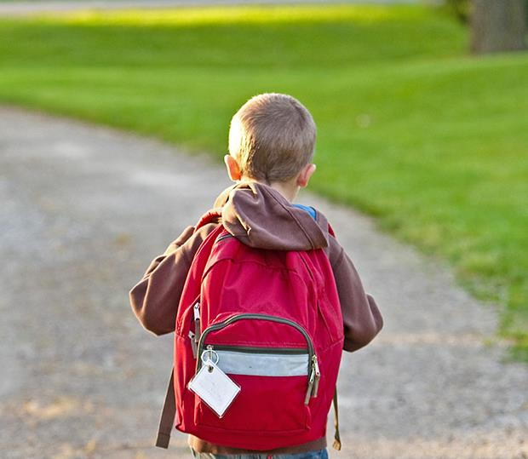
Great work!
Keep it up!

