Slide 1

Unit 7
Year 6
Makedonitissa A’
Primary School

Slide 2
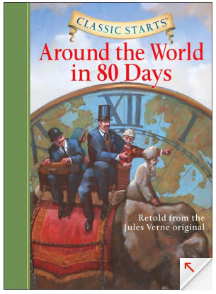
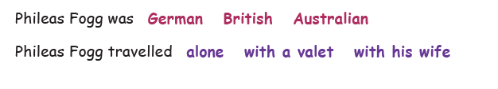
Reading
P.B. pg 46
Do you know the story ‘Around the world in 80 days’?
It is a classic novel by Jules Verne about a man called Phileas Fogg.
Let’s read and find out more things about it!
Before we do, choose what you think is the right answer.
Now, read and check your answers.

Slide 3
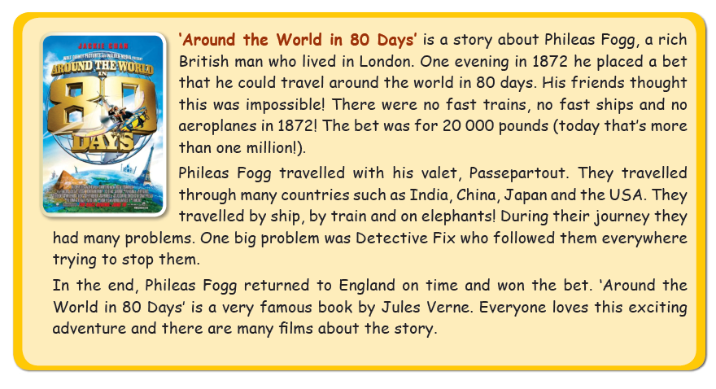

Slide 4
Now, click below and answer the questions.
https://forms.office.com/Pages/ResponsePage.aspx?id=z-jb7DjOmkS2fbqA5mVJGqahnHa_UEdLlez_SucrdY9UMTFMRzk5RFhLU1IzN1FVVDc1R1ZLUDBSMS4u
You can watch an animated storytelling of the book here:
https://www.youtube.com/watch?v=czRCCmEwguo

Slide 5

Great work!
Keep it up!

