Slide 1
Unit 8
Year 5
Makedonitissa A’
Primary School

Slide 2
Let’s remember:
Watch this video on school subjects. What’s your favourite school subject?
https://www.youtube.com/watch?v=AnZxeX_8mVk
Now write your school subjects in the boxes below
(Science, art, music, physical education, geography, Greek, maths, history, design and technology, English, religious education)

Slide 3
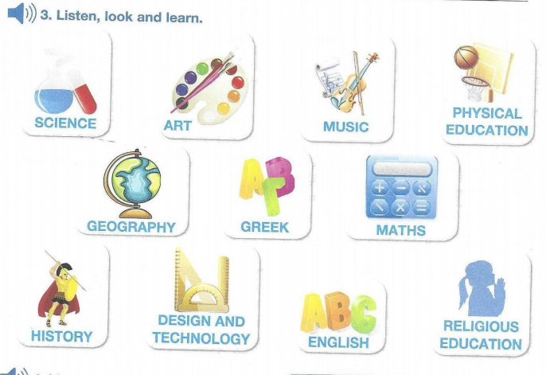
PB pg 49 ex.3

Slide 4
Activity Book pg43, ex.3.
Find the scrambled words:

Slide 5
Click on any of the links below to play some practice games:
https://learnenglishkids.britishcouncil.org/word-games/school-subjects
https://learnenglishkids.britishcouncil.org/comment/56516
https://www.gamestolearnenglish.com/vocab-game/ please click on SUBJECTS at the ‘select content’ page.
https://www.liveworksheets.com/worksheets/en/English_as_a_Second_Language_(ESL)/School_subjects/School_subjects_-_Drag_and_drop_rc9811du

Slide 6
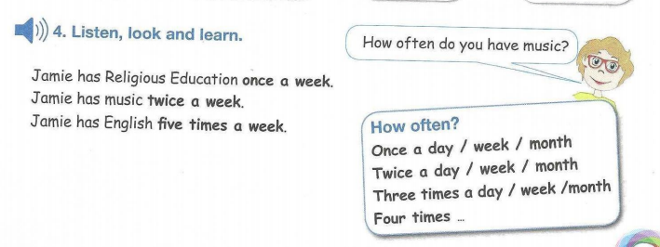
Look and learn. Pupil’s Book pg.49
Always, never, sometimes, usually, often,
never, every day/week/month

Slide 7
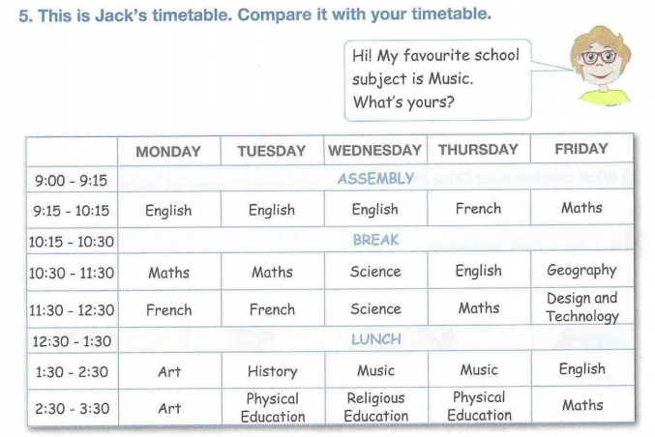
PB pg 50 ex5 .

Slide 8
PB pg 50 ex5 .
Remember:
on + day ex. on Mondays
at + time ex. at four o’clock

Slide 9
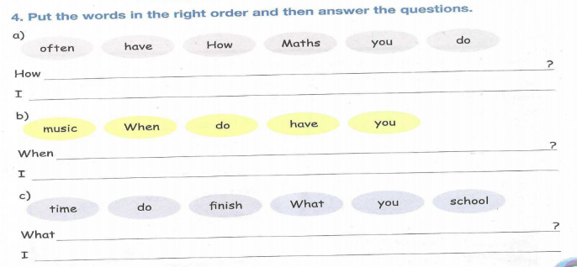
AB pg 43 ex 4.

Slide 10
Make YOUR ideal (perfect) timetable.
Time | Monday | Tuesday | Wednesday | Thursday | Friday

Slide 11
Great work!
Keep it up!

