Slide 1
ΔΗΜΟΤΙΚΟ ΣΧΟΛΕΙΟ ΜΑΚΕΔΟΝΙΤΙΣΣΑΣ Α΄
ΠΡΟΓΡΑΜΜΑ ERASMUS PLUS
Project: 2020-1-CY01-KA101-065818
“ICT tools for a Creative and Collaborative Classroom”
Σχολική Χρονιά: 2020-2022

Slide 2
Europass, Florence, Italy May30th-May 4th 2022
Δημοτικό Σχολείο Μακεδονίτισσας Α΄
Σχολική Χρονιά 2022-23
Μαρία Χρίστου

Slide 3
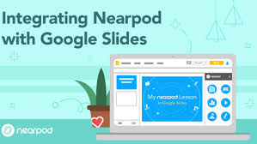
Let’s build together a playful lesson with Nearpod!
Interactive slides
Make any slides-based lessons interactive and gather data on student understanding by adding formative assessments, simulations, and dynamic media.
Or choose from thousands of ready-to-teach, customizable, standards-aligned lessons from teacher favorite brands.

Slide 4
Interactive videos
Create active video experiences to check for understanding with built-in interactive questions.

Slide 5
Gamification & activities
Deepen student understanding and engagement through gamification and activities like Time to Climb, Matching Pairs, Draw It, and NEW Drag & Drop.
Create your own or choose from thousands of activities across grades and subjects.

Slide 6
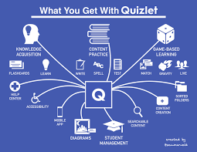
It’s time for a Quizlet.
90% of students who use Quizlet report higher grades.

Slide 7
Personalized instruction made easy
With different study modes like Flashcards, Learn, Test, and Match, students can pick what works best for their learning. Quizlet tracks their progress and provides instant feedback on where to focus.
Quizlet helps teachers engage students of all levels through curriculum-based materials, interactive study methods and games.
Save time on lesson material creation
Search from over 500 million study sets created by other students and teachers to find relevant content for your class. If you want to make your own, Quizlet makes set creation fast with our predictive word and suggested images features.

Slide 8
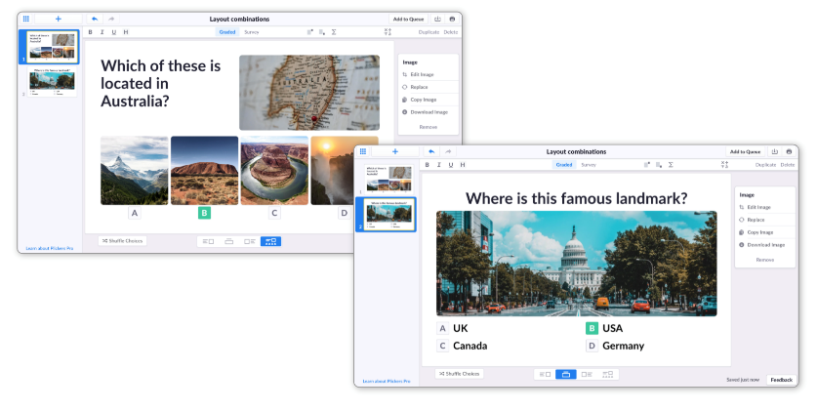
Plickers?
What is Plickers?
Now Playing - Overview
Plickers is a free, accessible and engaging educational tool used by millions of teachers around the world to assess their students and collect instant results in the classroom.
The Plickers platform has been designed with accessibility as a top priority, meaning it's perfect for the vast majority of educational settings. Students answer questions by holding up unique cards, so there's no need for student devices or accounts, and sessions can even be taken offline if no internet connection is available.
As the teacher, you will have access to a free Plickers account. These are designed for individual use, which will allow you to create a bespoke online environment that's tailored to your own unique teaching schedule.
Now Playing is the platform you'll use in class to ask your questions and gather your students' answers. Your content is displayed by the Now Playing screen on plickers.com, and controlled by the Plickers app.

Slide 9
Goosechase! How people use Goosechase? Quick to set up, easy to play!
The Goosechase mobile app is great for kids 5 to 95+. Just download and go!
Join codes help participants easily find your Experience
Send messages to your participants at any time
Goosechase is an online platform that helps you create interactive experiences.

Slide 10
Goosechase is a digital tool and app for creating multimodal scavenger hunts. Using Goosechase, students can take photos or videos of scavenger hunt items, solve riddles and word puzzles, and tag themselves at a GPS location, such as a historical monument.

Slide 11
