Slide 1
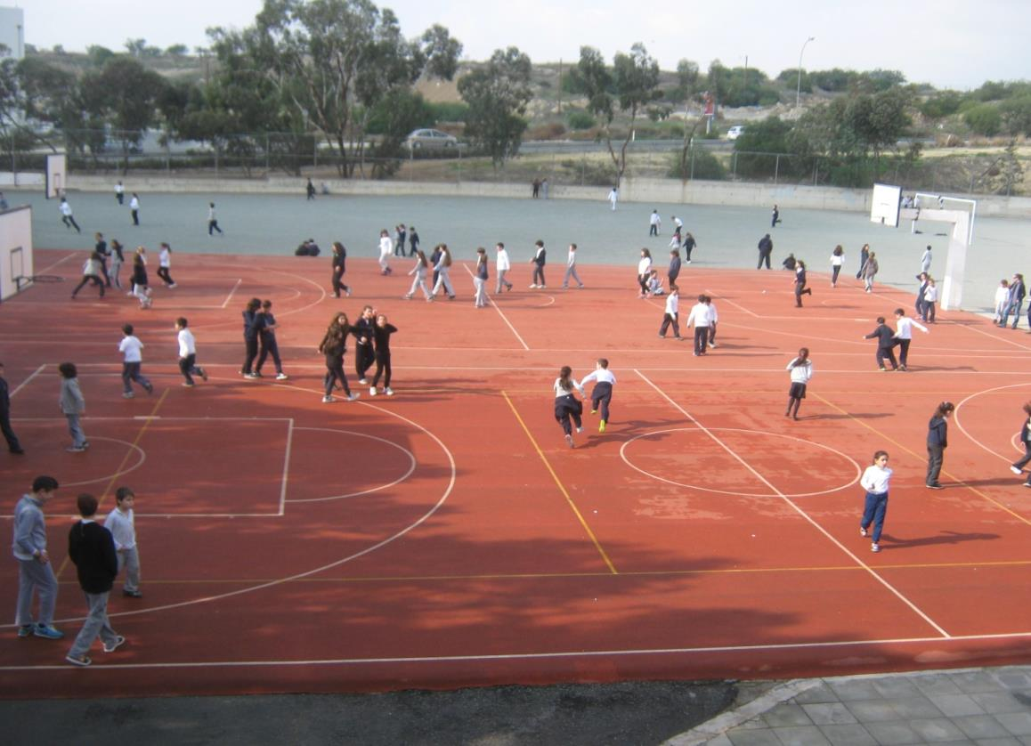
HELLO FROM CYPRUS!

Slide 2
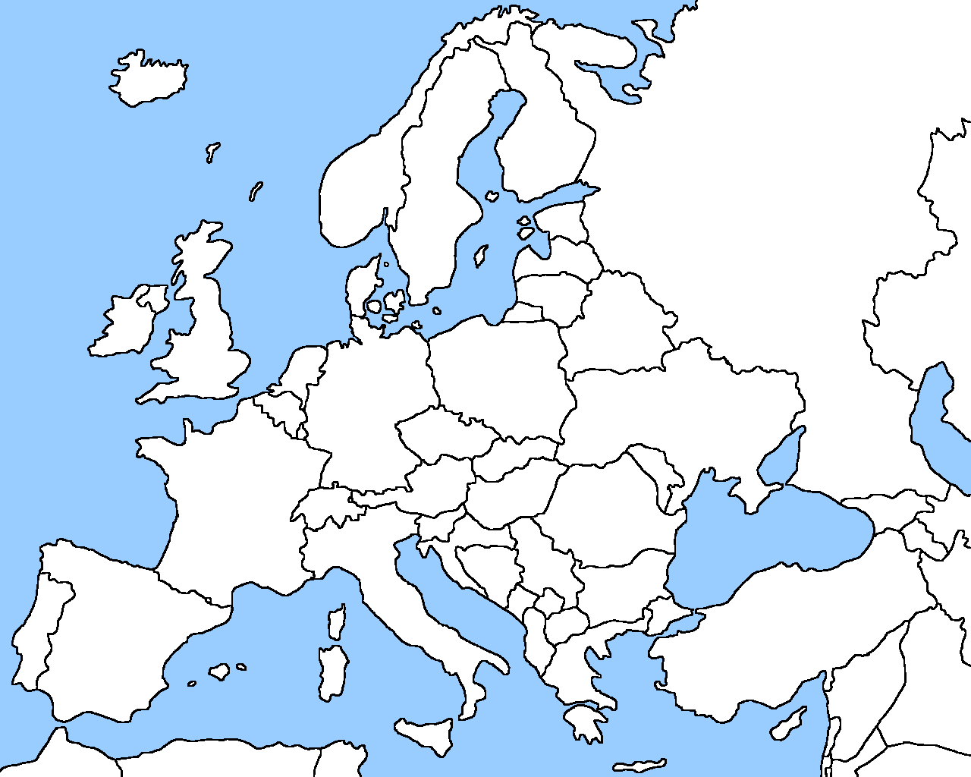

THIS IS OUR COUNTRY
CYPRUS

Slide 3
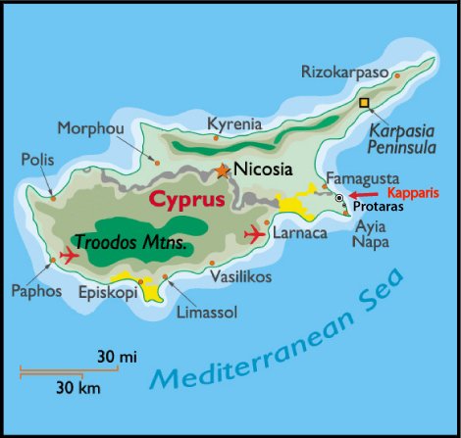
CYPRUS
MAKEDONITISSA

Slide 4
A few words about Makedonitissa
Makedonitissa is situated at the outskirts of Nicosia (about 5 Km away) and is part of the municipality of Engomi.
The population of Engomi is about
18 000.
There are three primary schools, one high school and two private universities in Makedonitissa.

Slide 5
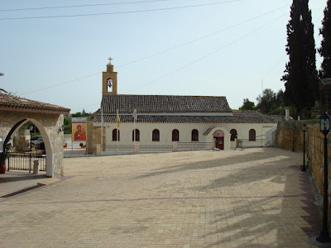
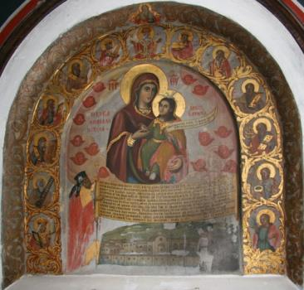
Greek – Orthodox
Churches at Makedonitissa
This is the monastery of “Panagia Makedonitissa”.
It’s the oldest church of Makedonitissa . The area is named after this church.

Slide 6
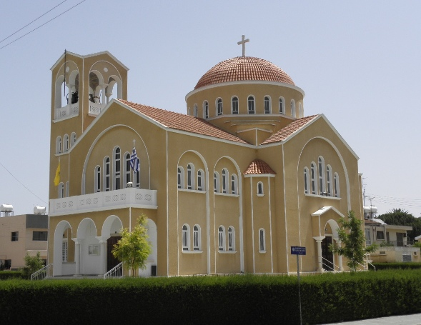
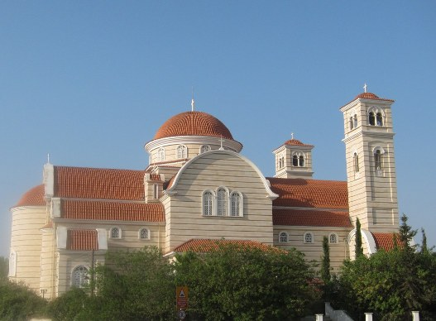
Greek – Orthodox
Churches at Makedonitissa
Church of All Saints
Church of Saint Panteleimon

Slide 7
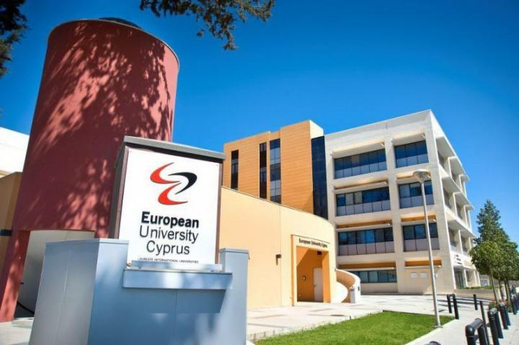
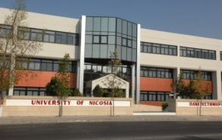
Universities in Makedonitissa

Slide 8
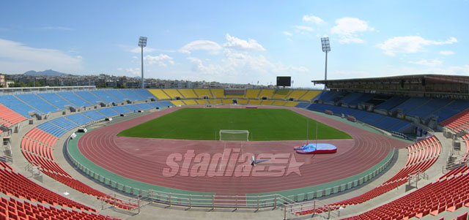
Athletic centers
The Makarios Stadium

Slide 9
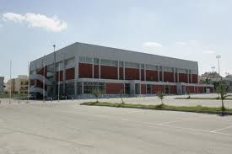
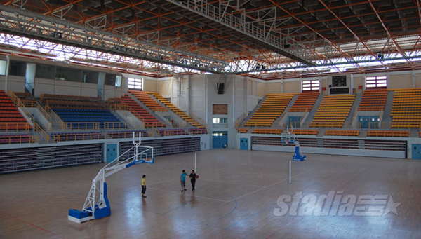
The “Liberty – Tassos Papadopoulos” athletic center

Slide 10
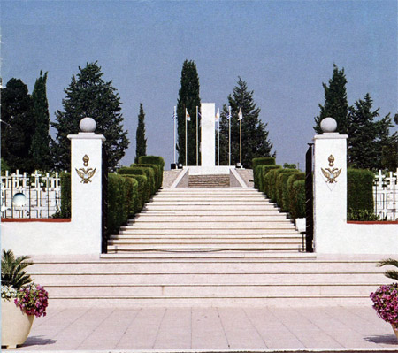
“Tymvos of Makedonitissa”
The military cemetery
Cemetery of Greek and Cypriot soldiers who died during the turkish invasion in Cyprus in 1974.

Slide 11
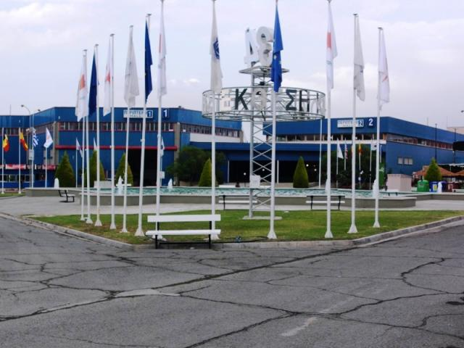
The Cyprus International Fair

Slide 12
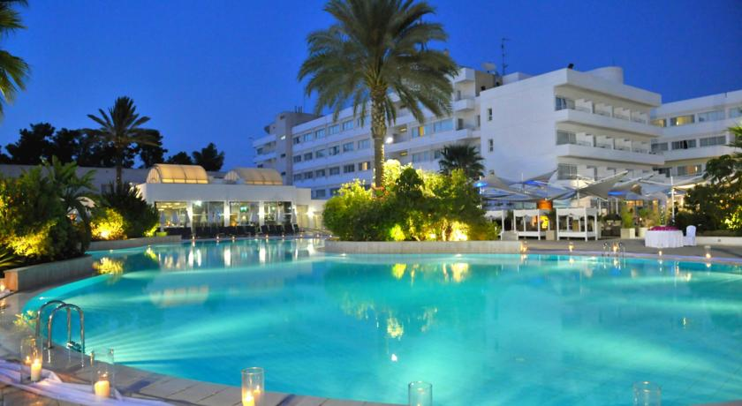
The Hilton Park Hotel

Slide 13
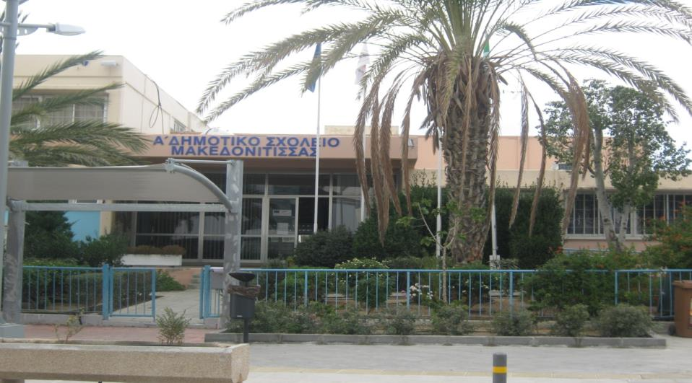
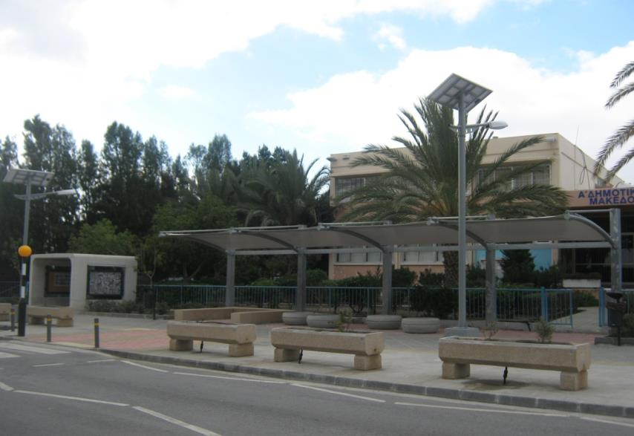
This is our school
A’ Makedonitissa primary school

Slide 14
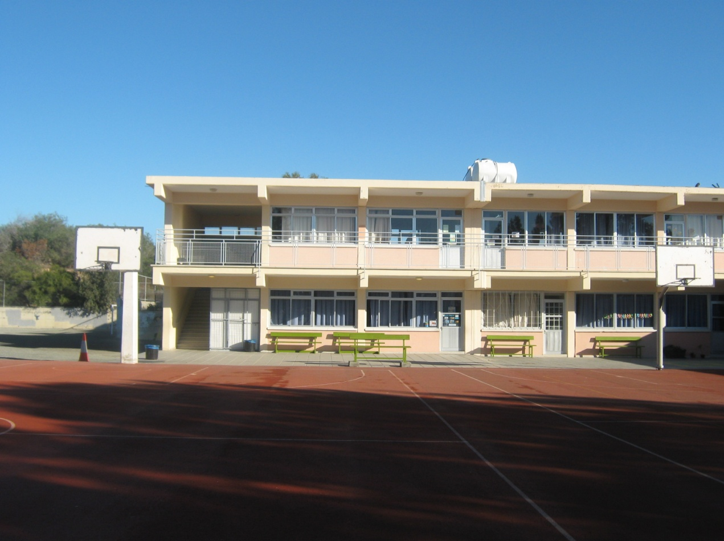
It was founded in 1987.

Slide 15
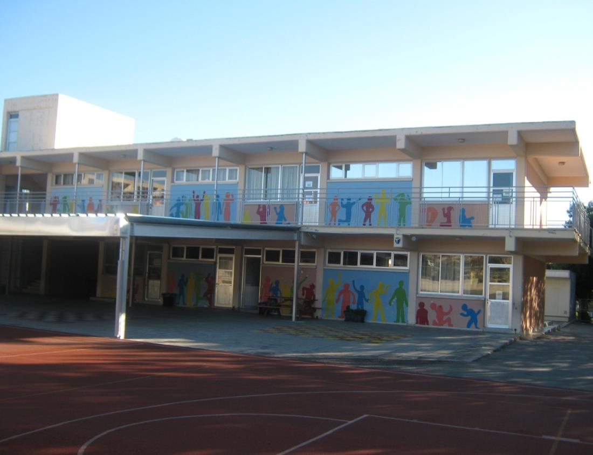
26 teachers are employed here.

Slide 16
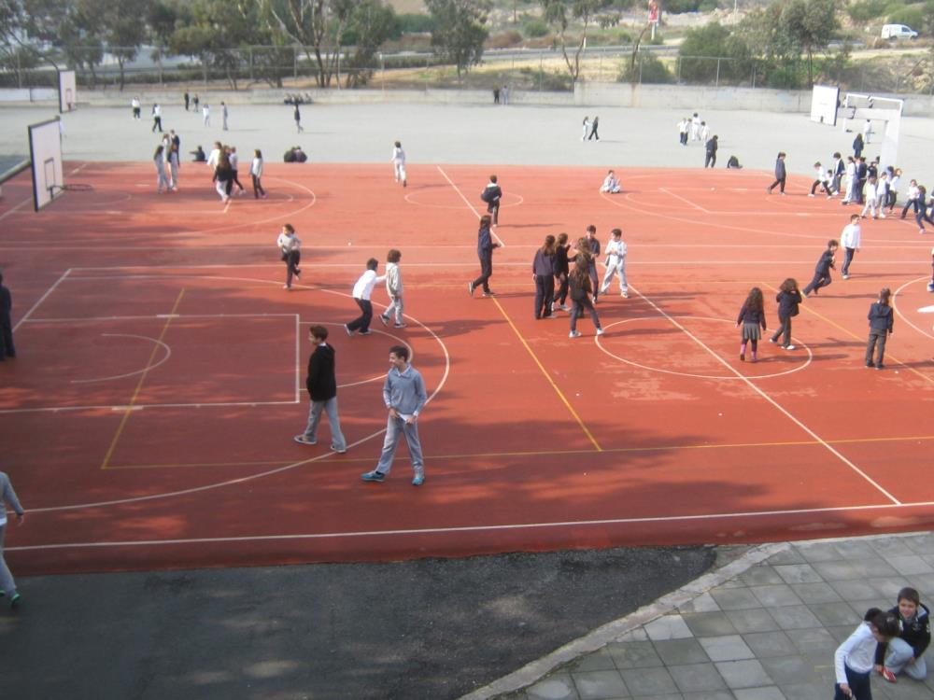
Our school has 302 students of 6 – 12 years old.

Slide 17
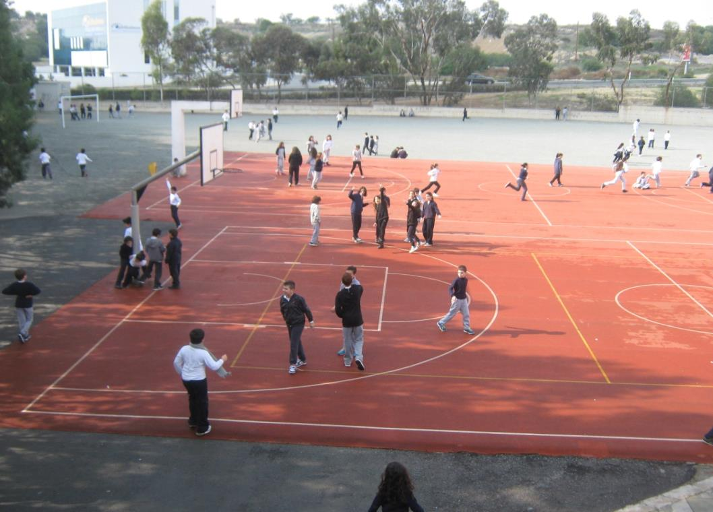
The children of our school are looking forward to start our project and communicate with you all!

Slide 18
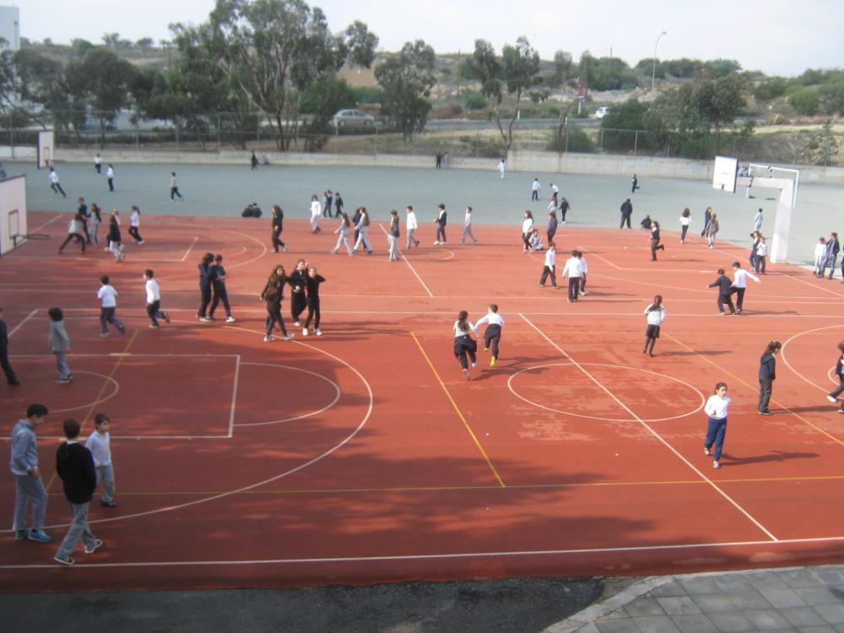
Thank you for your attention!
We are looking forward to hearing from you soon!

