Slide 1
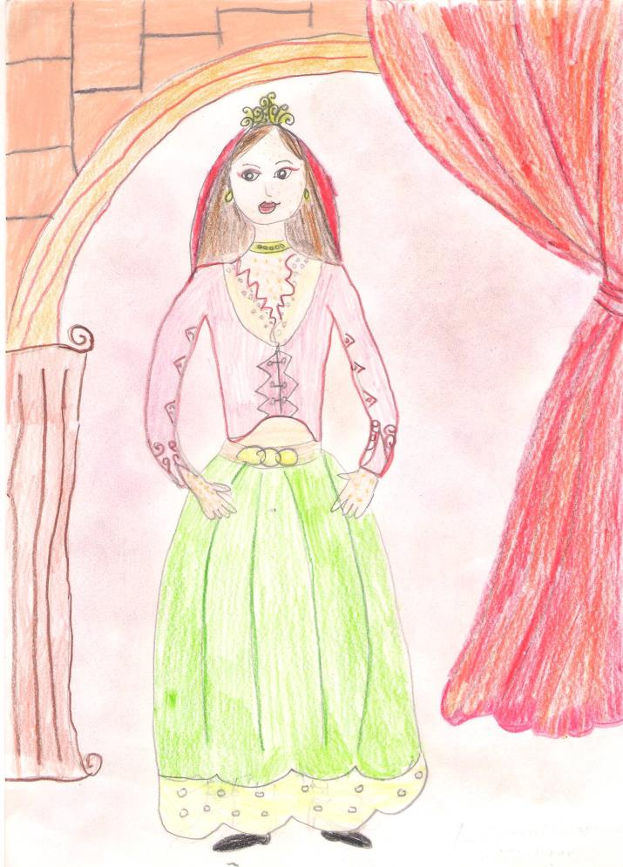
The Sick Princess
A medieval fairytale from Cyprus, illustrated by students of
Makedonitissa A’ Primary School in Nicosia, for the implementation of the eTwinning project:
“Let’s present a fairytale from our country to Europe”
May 2014

Slide 2
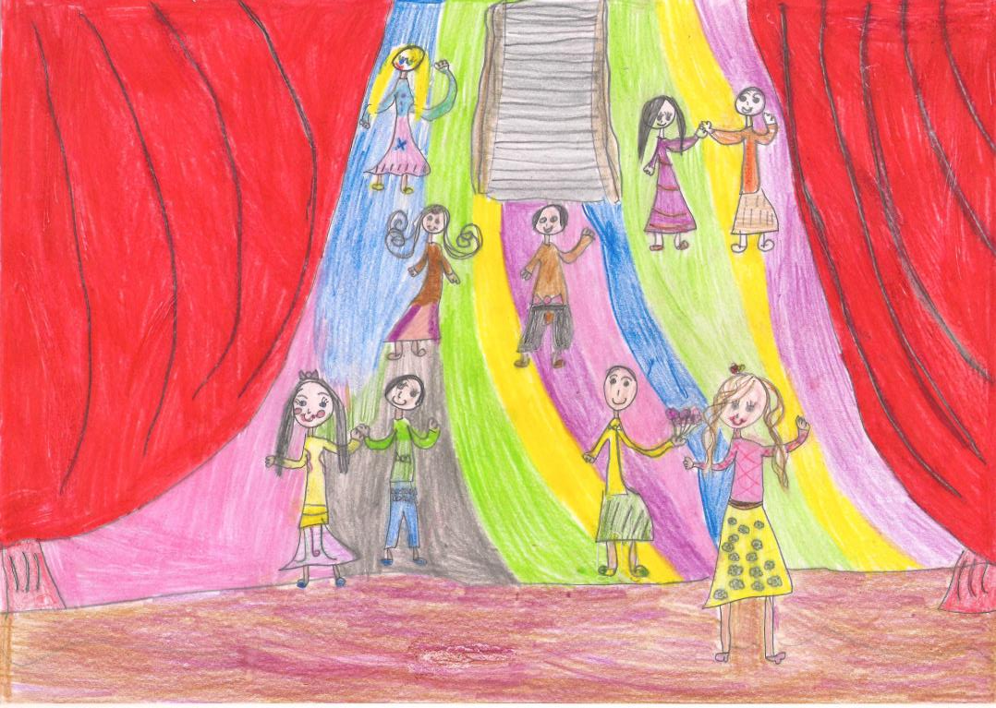
Once upon a time, a princess lived in Nicosia, the capital of the lovely island of Cyprus. Her name was Maria De Molino and she was very beautiful. Her days were passing joyfully, with dances in palaces, walks and excursions outdoors.

Slide 3
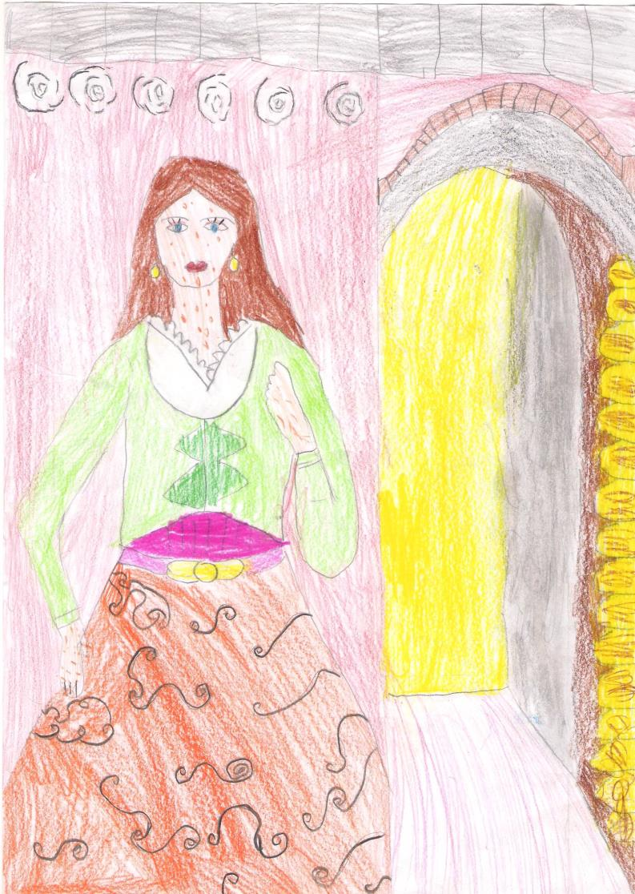
Unfortunately, her destiny took away her happiness. All of a sudden, she was struck by an incurable disease. Her body was full of wounds. No doctor could cure her. As her disease was contagious, she had to move away from her palace in Nicosia. Along with her servants, she went up to Buffavento Castle, at Pentadaktylos mountains.

Slide 4
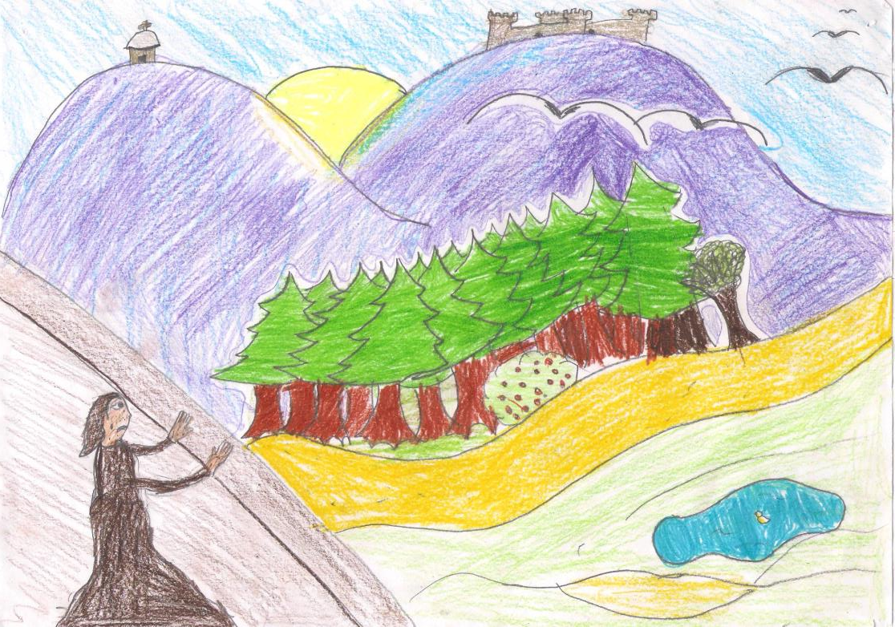
From there, she admired the beauties of the island daily, looking down from the peak of the mountain where the castle stood:
“How beautiful this island is!”, she thought to herself sorrowfully, locked away as she was.

Slide 5
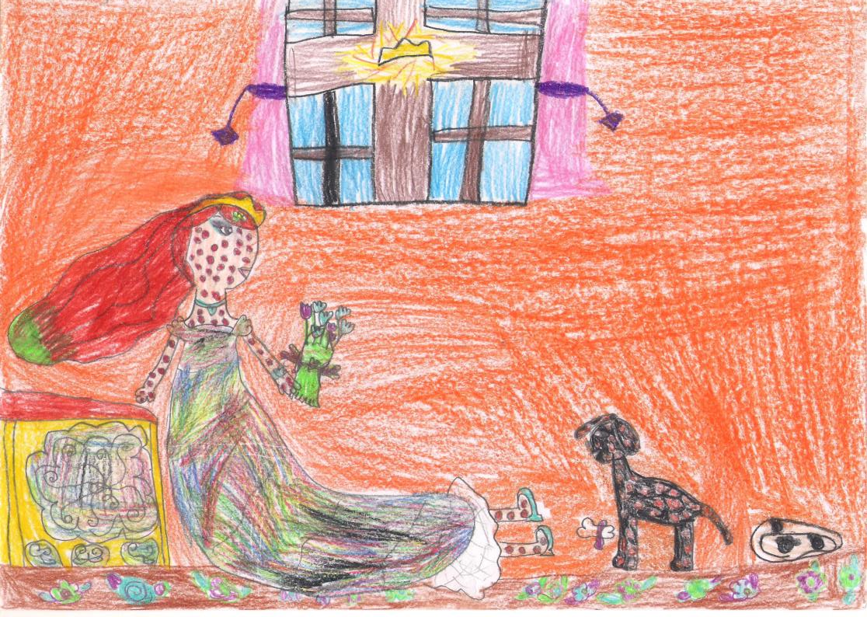
Her loyal dog was her only consolation. The days and especially the nights weren’t so lonely with her beloved dog keeping her company. Unfortunately though, her dog, being so close to her, also caught the disease that the princess had. The princess was now suffering not only for herself, but for her beloved dog as well.

Slide 6
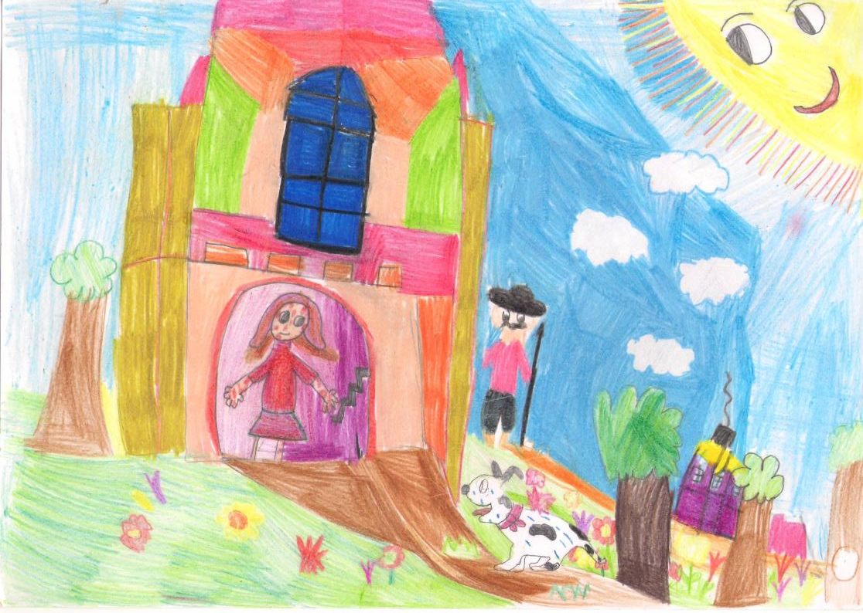
One day the dog was lost. The servants looked for it everywhere, but the dog had vanished. Suddenly, late in the afternoon, the princess saw her little dog running back to the castle. It was wet, but looked very cheerful.

Slide 7
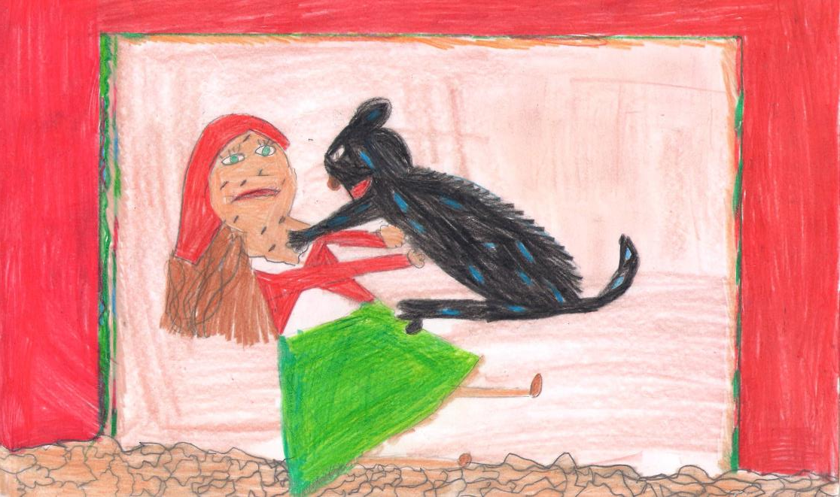
As she embraced it, she noticed that the wounds on its body had begun to heal. Seeing that, a ray of hope flickered in her heart.

Slide 8
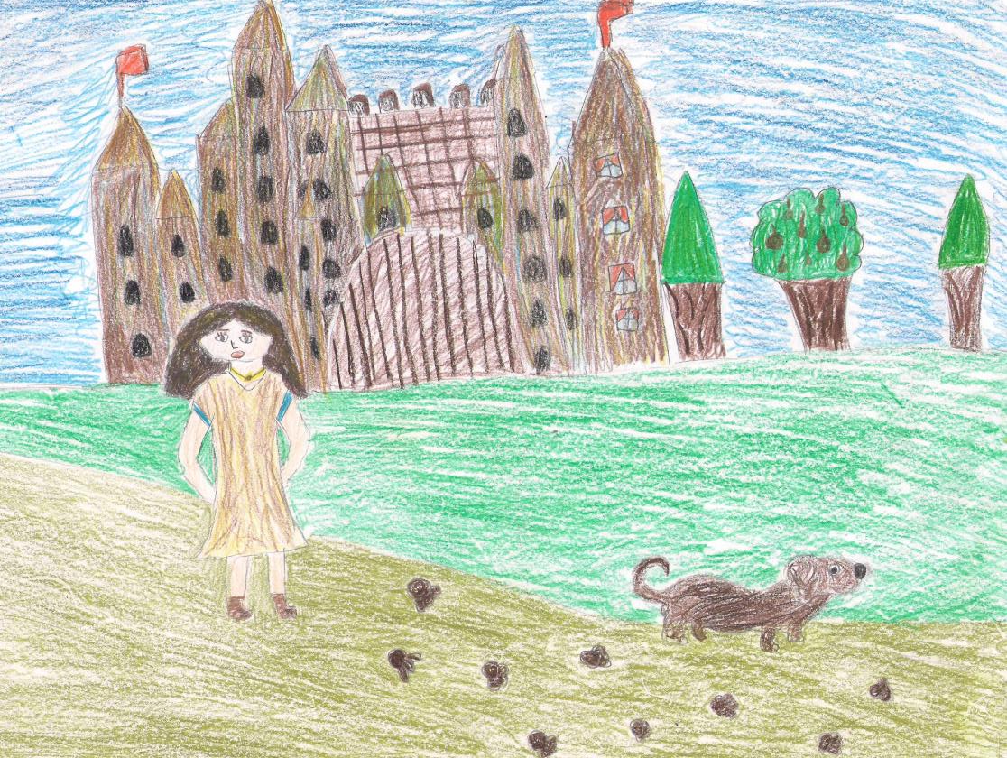
The next morning she followed her dog, as it was going down the mountain.

Slide 9
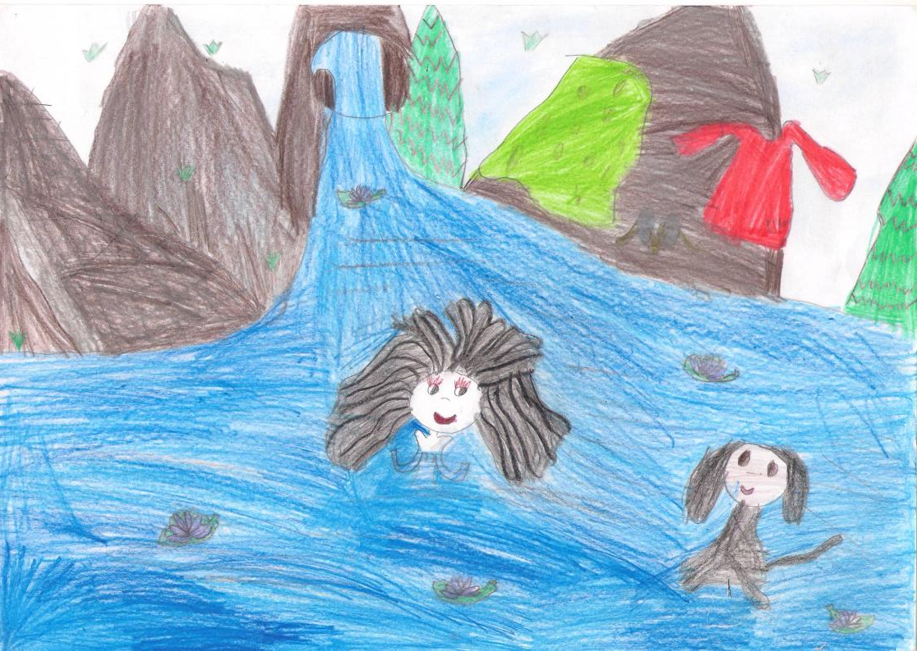
The dog reached a small spring with crystal, sparkling water. The princess saw her dog diving into the water and immediately looking relieved. The dog began barking, calling her to get into the water as well.

Slide 10
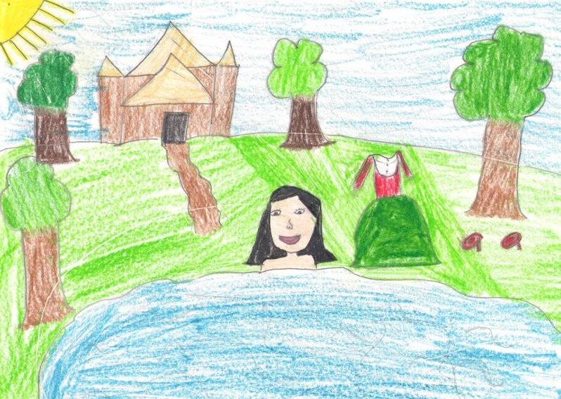
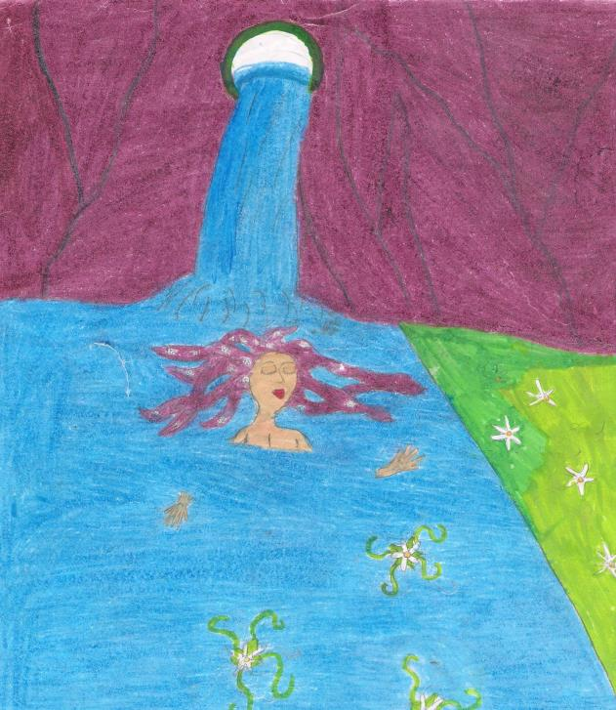
The princess didn’t hesitate a minute. She looked around her and, seeing that nobody was there, took her cloths off and dived into the crystal, sparkling spring. She immediately felt relieved too!

Slide 11
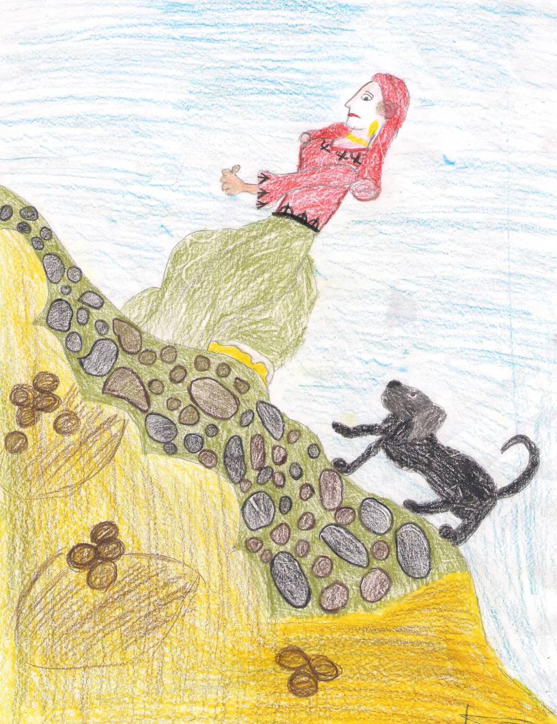
At noon, as she was walking back to the castle, she felt energetic, happy and relaxed. She wondered whether the water of that spring could cure her disease.
From that moment on, she decided to visit the spring every day.

Slide 12
In a month’s time she was completely cured! She therefore began preparations for her return home in Nicosia, along with her beloved dog, which, by then, was also completely cured.

Slide 13
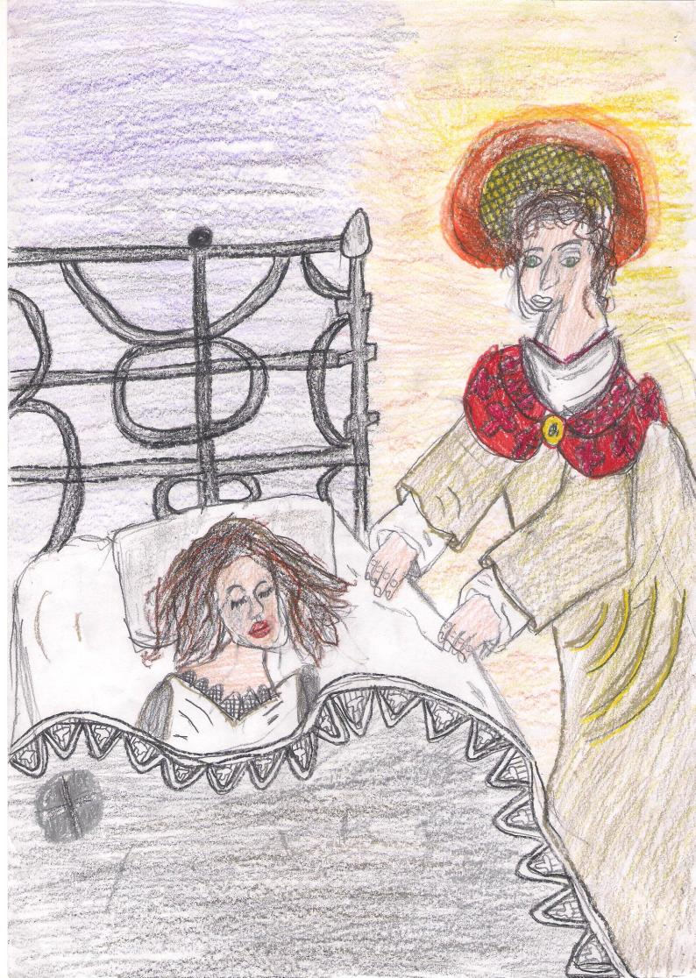
However, one night she had a strange dream. Saint John Chrysostom appeared in her dream and told her:
“Where are you going, Maria? Here is your place, the place where you have been cured. Beside my spring you should build a church and a monastery. You should name them after me, and live there forever.”

Slide 14
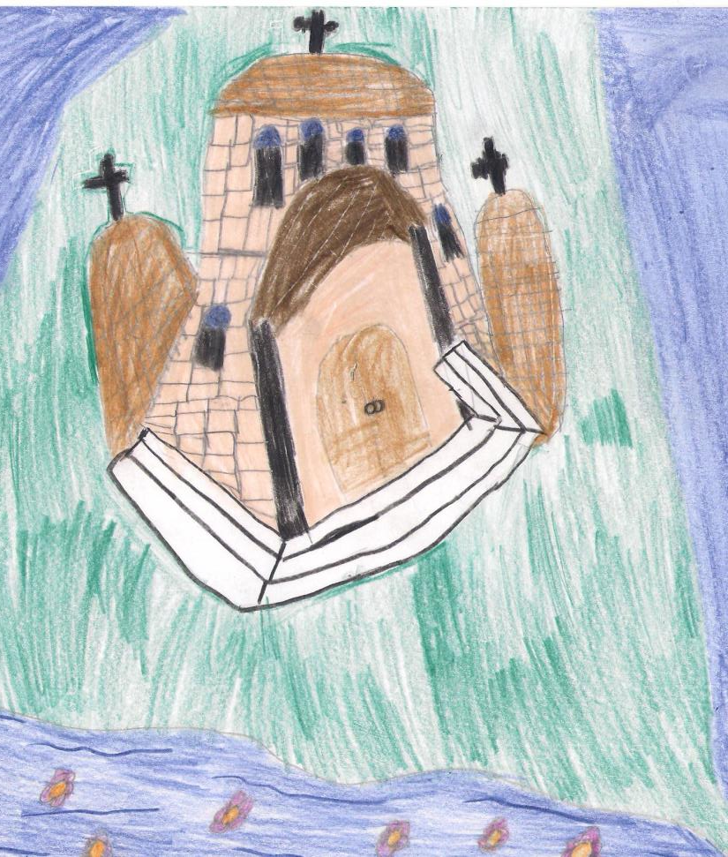
The princess woke up, but the words of the Saint were still resounding in her ears. She promptly started building the church and the monastery, as the Saint had instructed her.
As soon as the villagers living there heard what she was trying to do, they willingly offered her all the help they could.

Slide 15
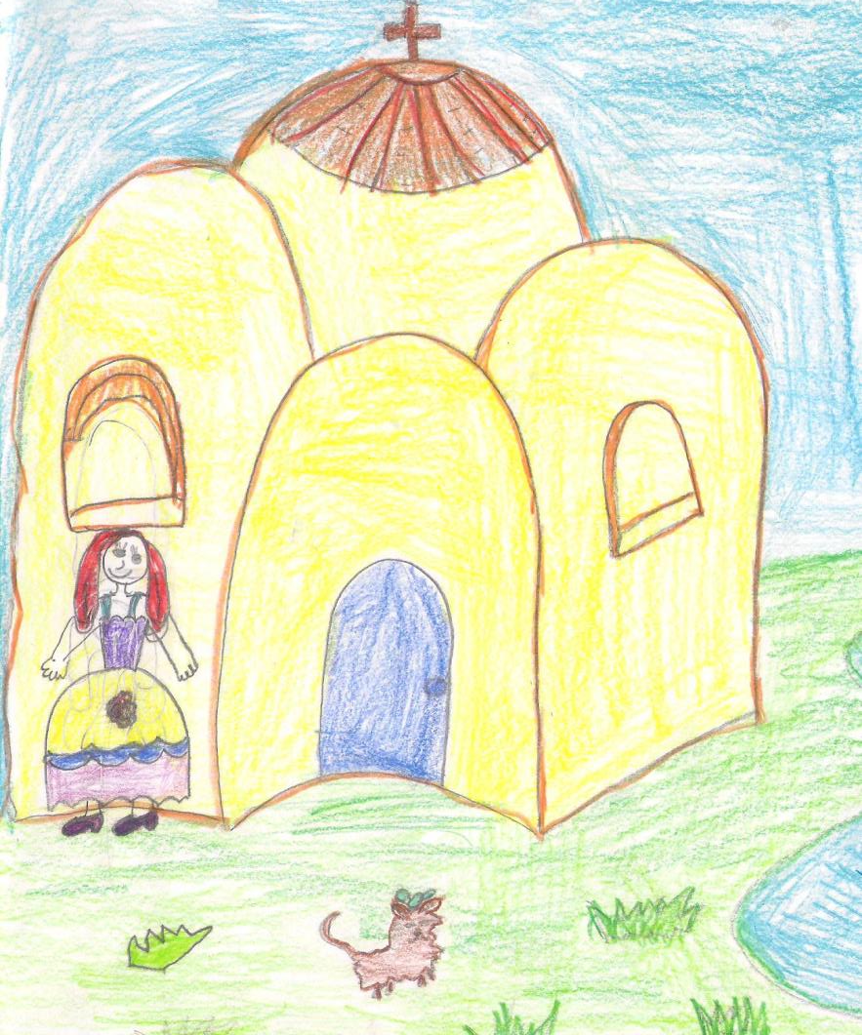
In a few months’ time, the church and the monastery were completed.
The princess, her loyal dog and all her servants lived there peacefully, praising Saint John until the end of their lives.

