Slide 1
Telling the time
Year 3
Makedonitissa A’
Primary School
Eleni Papageorgiou 2020

Slide 2
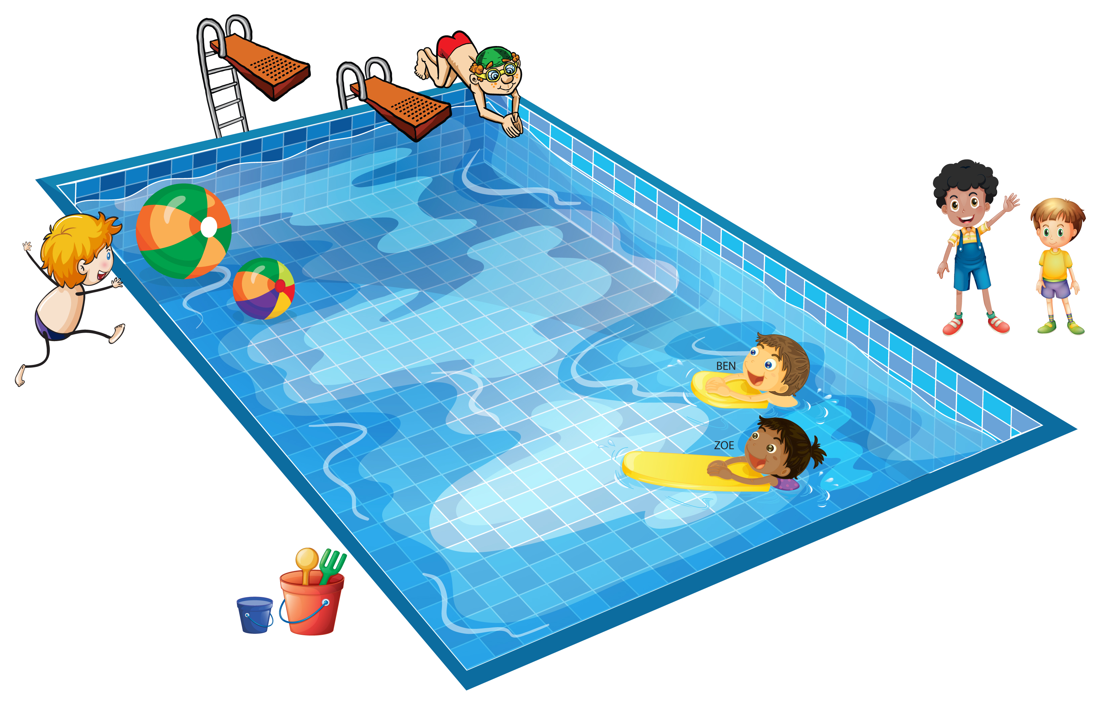
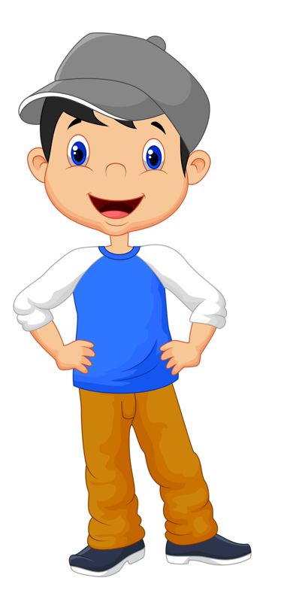
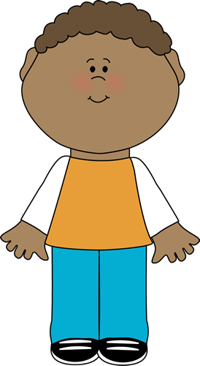
Look and learn
What time is it?
It’s three o’clock. Time for
my swimming lesson!

Slide 3
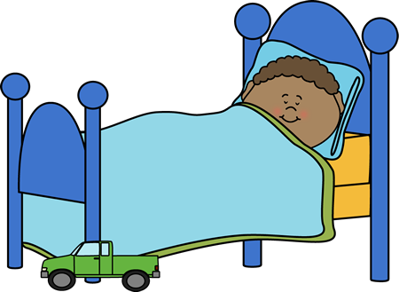
Look and learn
What time is it?
It’s nine o’clock. Time to go to bed.

Slide 4
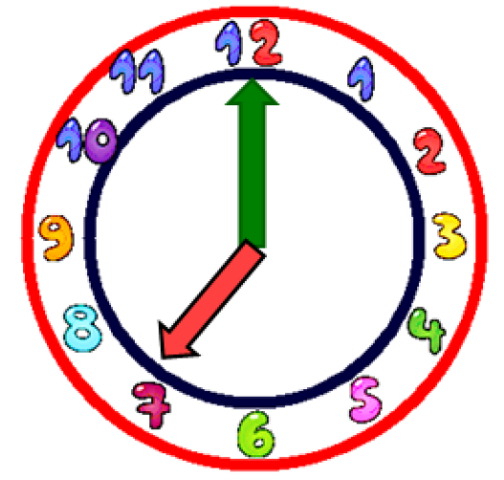
Look and learn
-What time is it?
- It’s
seven
o’clock.

Slide 5
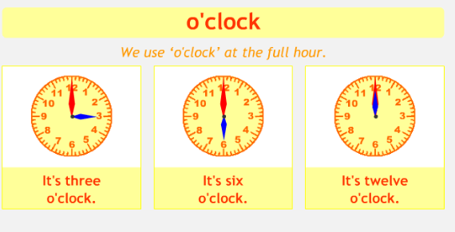
Look and learn

Slide 6
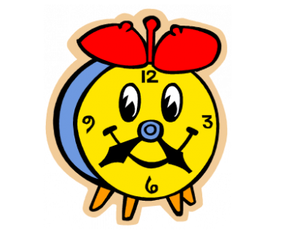
Click below to watch some stories on time telling.
https://safeYouTube.net/w/LRLC
Now listen to this fun song and try to sing along:
https://safeYouTube.net/w/SoMC

Slide 7
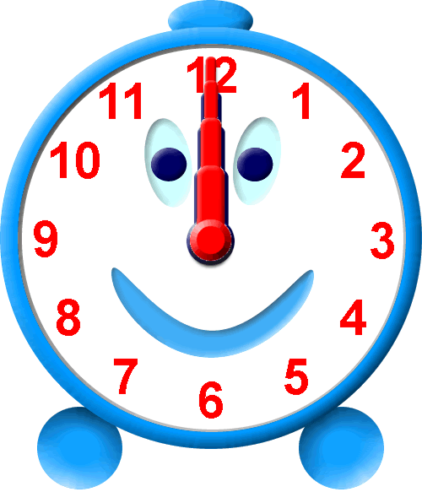
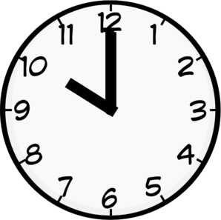
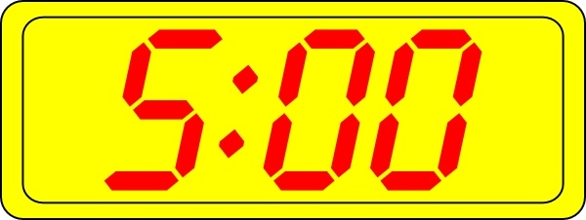
Match
It’s ten o’clock.
It’s five o’clock.
It’s twelve o’clock.
It’s seven o’clock.

Slide 8
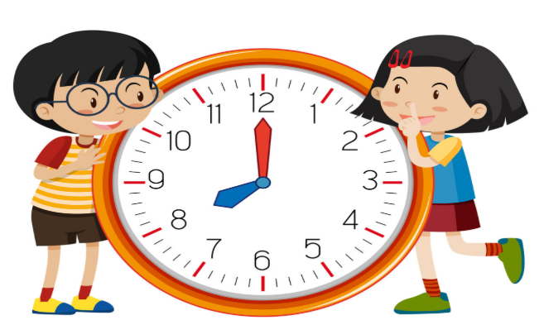
Now, you can do:
exercise 2 on page 63 in your Pupil’s Book
exercise 1 on page 51 in your Activity Book

Slide 9
Great work!
Keep it up!

