Slide 1
Wellbeing in Nature – Erasmus+ in Lisbon
Sharing tools to bring calm, creativity & connection into our classrooms
Noni Eleftheriou 2024-25
Project 2024-1-CY01-KA122-SCH-000209502
Green Horizons: Learning new ways to raise the students’ Environmental Awareness,for building more eco-friendly societies.

Slide 2
Course Overview
• Name: Wellbeing in Nature – Outdoor Activities for Mental and Physical Health
• Provider: Europass Teacher Academy
• Location: Lisbon
• Duration: 1 week
• Focus: Ecopsychology, mindfulness, social-emotional learning & Biophilic Design

Slide 3
Why bring nature into education?
• Nature reduces stress and anxiety
• Improves focus and academic performance
• Boosts social-emotional learning
• Builds empathy & inclusion

Slide 4
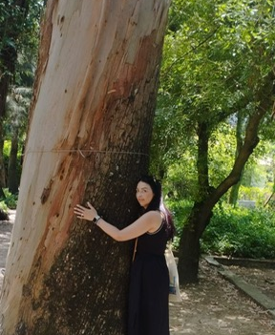
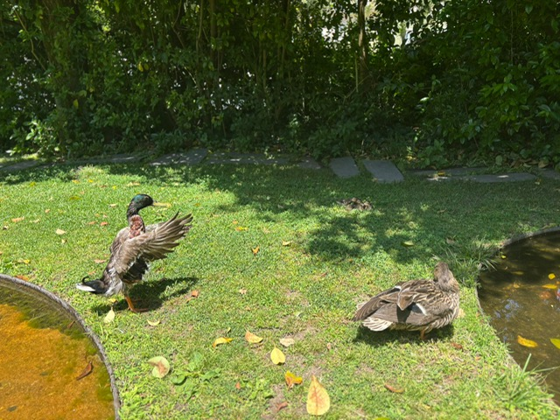
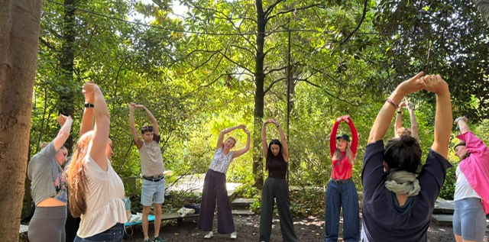

Slide 5
What we did each day
Day 1: Icebreakers, school presentations, Eco-Psychology intro
Day 2: Beach mindfulness & strength-based activities
Day 3: Forest team-building & value exploration
Day 4: Nature-inspired creativity, Gratitude installation
Day 5: Biophilic Design + final projects
Day 6: Evaluation & cultural excursion

Slide 6
Some of my favourite activities
• Outdoor stretching & mindfulness
• Gratitude installation in a garden
• Guided nature visualization
• Creative tasks using natural materials

Slide 7
How we can apply this at our school
• Short outdoor mindfulness breaks
• Nature corner in the classroom
• Biophilic design: natural light, plants, textures
• Class projects in school gardens
• Digital visualizations of calming landscapes

Slide 8
What I gained
• A calmer mind and stronger connection with nature
• Creative ways to engage students
• Ideas to enhance well-being and inclusion
• A network of inspiring educators

Slide 9
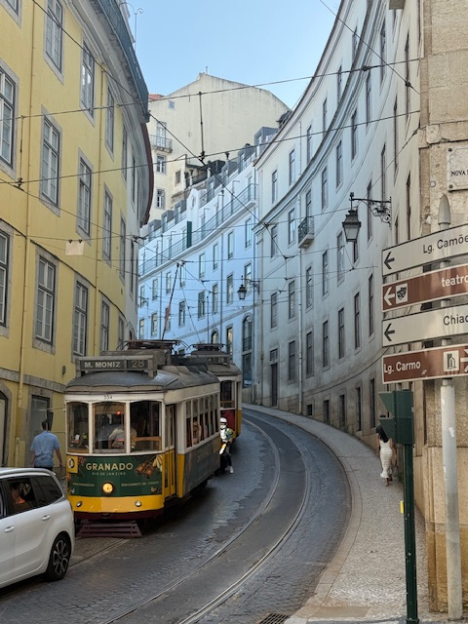
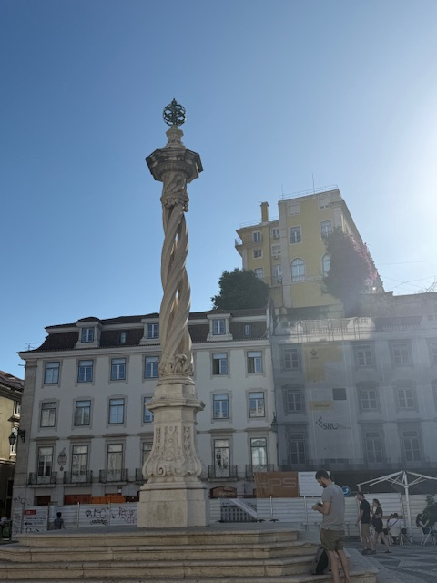
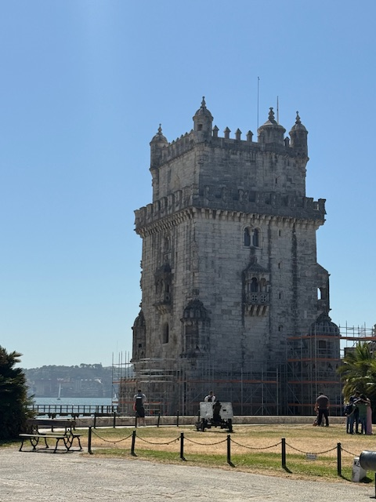

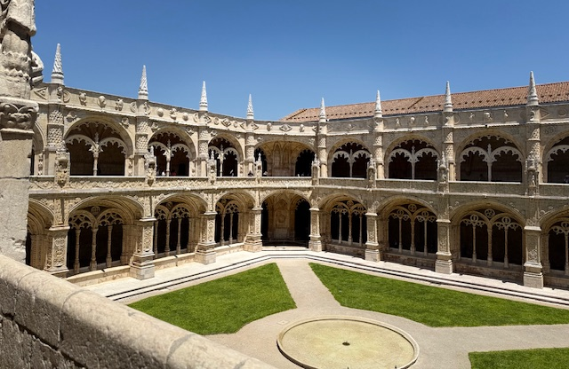
Cultural Activities

Slide 10
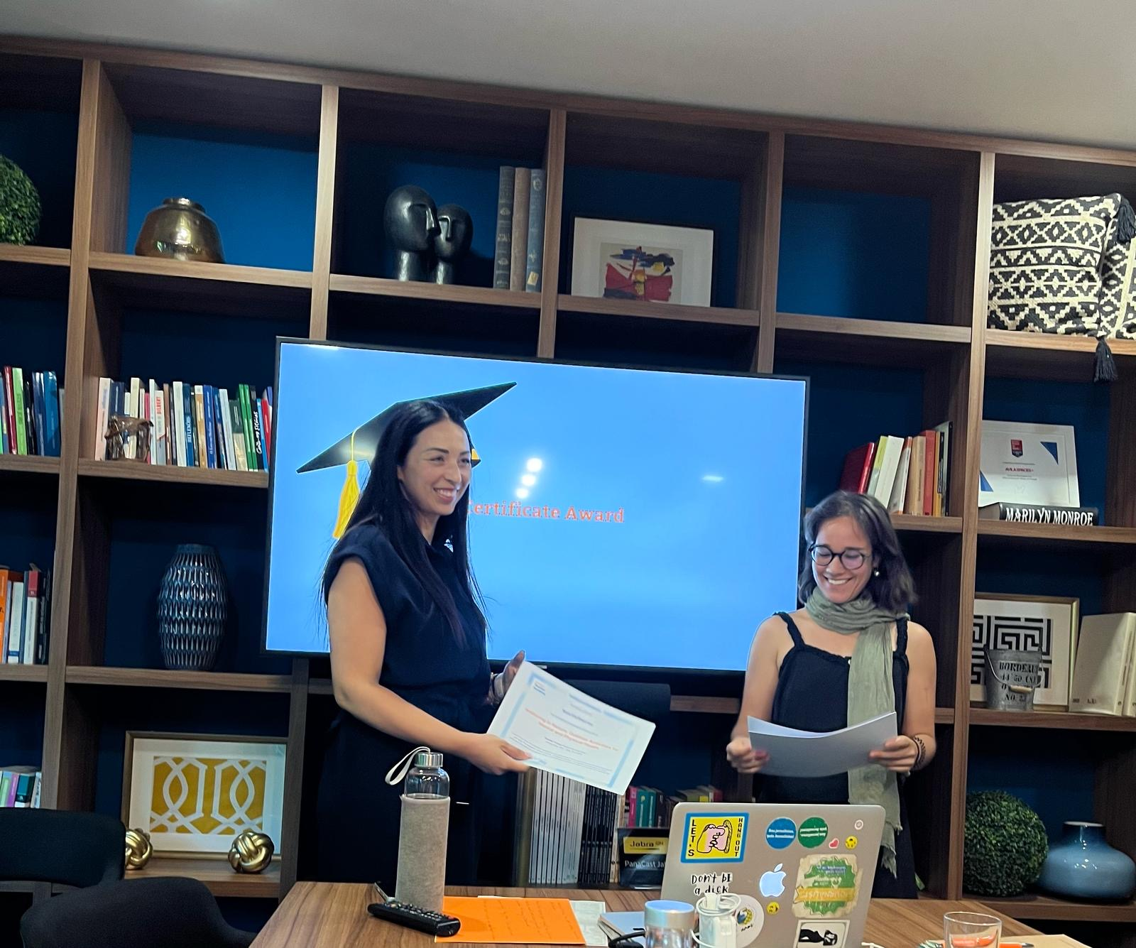

Slide 11
Thank you for listening! 🌿
• Erasmus+ made this learning possible
• Open to questions or collaboration!

